Slide 1
ARRAYS

Slide 2
INTRODUCTION
An array is a collection of similar data elements.
These data elements have the same data type.
The elements of the array are stored in consecutive memory locations and are referenced by an index (also known as the subscript).
Declaring an array means specifying three things:
The data type- what kind of values it can store ex, int, char, float
Name- to identify the array
The size- the maximum number of values that the array can hold
Arrays are declared using the following syntax.
type name[size];
1st element | 2nd element | 3rd element | 4th element | 5th element | 6th element | 7th element | 8th element | 9th element | 10th element
marks[0] marks[1] marks[2] marks[3] marks[4] marks[5] marks[6] marks[7] marks[8] marks[9]

Slide 3
ACCESSING ELEMENTS OF THE ARRAY
To access all the elements of the array, you must use a loop. That is, we can access all the elements of the array by varying the value of the subscript into the array. But note that the subscript must be an integral value or an expression that evaluates to an integral value.
CALCULATING THE ADDRESS OF ARRAY ELEMENTS
int i, marks[10];
for(i=0;i<10;i++)
marks[i] = -1;
Address of data element, A[k] = BA(A) + w( k – lower_bound)
Here, A is the array
k is the index of the element of which we have to calculate the address
BA is the base address of the array A.
w is the word size of one element in memory, for example, size of int is 2.
99 | 67 | 78 | 56 | 88 | 90 | 34 | 85
Marks[0] marks[1] marks[2] marks[3] marks[4] marks[5] marks[6] marks[7] marks[7] 1000 1002 1004 1006 1008 1010 1012 1014
Marks[4] = 1000 + 2(4 – 0)
= 1000 + 2(4) = 1008

Slide 4
STORING VALES IN ARRAYS
Initialize the elements
Initialization of Arrays
Arrays are initialized by writing,
type array_name[size]={list of values};
int marks[5]={90, 82, 78, 95, 88};
Store values in the array
Input values for the elements
Assign values to the elements
Assigning Values
Inputting Values
int i, marks[10];
for(i=0;i<10;i++)
scanf(“%d”, &marks[i]);
int i, arr1[10], arr2[10];
for(i=0;i<10;i++)
arr2[i] = arr1[i];
CALCULATING THE LENGTH OF THE ARRAY
Length = upper_bound – lower_bound + 1
Where, upper_bound is the index of the last element
and lower_bound is the index of the first element in the array
99 | 67 | 78 | 56 | 88 | 90 | 34 | 85
Marks[0] marks[1] marks[2] marks[3] marks[4] marks[5] marks[6 marks[7]]
Here, lower_bound = 0, upper_bound = 7
Therefore, length = 7 – 0 + 1 = 8

Slide 5
WRITE A PROGRAM TO READ AND DISPLAY N NUMBERS USING AN ARRAY
#include<stdio.h>
#include<conio.h>
int main()
{
int i=0, n, arr[20];
clrscr();
printf(“\n Enter the number of elements : “);
scanf(“%d”, &n);
for(i=0;i<n;i++)
{
printf(“\n Arr[%d] = “, i);
scanf(“%d”,&num[i]);
}
printf(“\n The array elements are “);
for(i=0;i<n;i++)
printf(“Arr[%d] = %d\t”, i, arr[i]);
return 0;
}

Slide 6
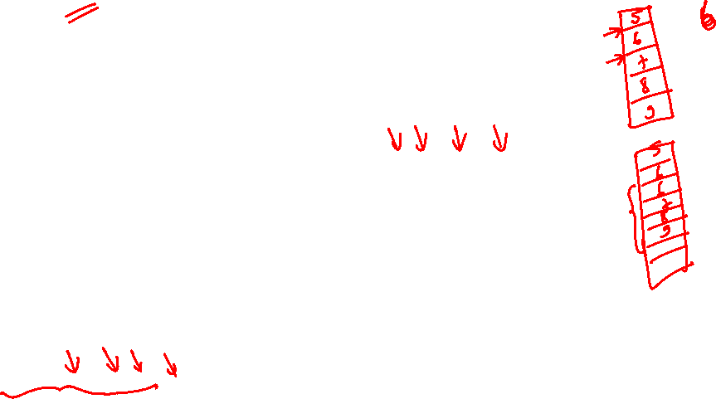
INSERTING AN ELEMENT IN THE ARRAY
Algorithm to insert a new element to the end of the array.
Step 1: Set upper_bound = upper_bound + 1
Step 2: Set A[upper_bound] = VAL
Step 3; EXIT
The algorithm INSERT will be declared as INSERT( A, N, POS, VAL).
Step 1: [INITIALIZATION] SET I = N
Step 2: Repeat Steps 3 and 4 while I >= POS
Step 3: SET A[I + 1] = A[I]
Step 4: SET I = I – 1
[End of Loop]
Step 5: SET N = N + 1
Step 6: SET A[POS] = VAL
Step 7: EXIT
Calling INSERT (Data, 6, 3, 100) will lead to the following processing in the array
45 | 23 | 34 | 12 | 56 | 20 | 20
45 | 23 | 34 | 12 | 12 | 56 | 20
Data[0] Data[1] Data[2] Data[3] Data[4] Data[5] Data[6]
Data[0] Data[1] Data[2] Data[3] Data[4] Data[5] Data[6]
45 | 23 | 34 | 12 | 56 | 56 | 20
45 | 23 | 34 | 100 | 12 | 56 | 20
Data[0] Data[1] Data[2] Data[3] Data[4] Data[5] Data[6]
Data[0] Data[1] Data[2] Data[3] Data[4] Data[5] Data[6]

Slide 7
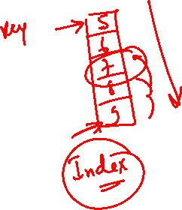
DELETING AN ELEMENT FROM THE ARRAY
Algorithm to delete an element from the end of the array
Step 1: Set upper_bound = upper_bound - 1
Step 2: EXIT
The algorithm DELETE will be declared as DELETE( A, N, POS).
Step 1: [INITIALIZATION] SET I = POS
Step 2: Repeat Steps 3 and 4 while I <= N - 1
Step 3: SET A[I] = A[I + 1]
Step 4: SET I = I + 1
[End of Loop]
Step 5: SET N = N - 1
Step 6: EXIT
45 | 23 | 12 | 56 | 56 | 20
45 | 23 | 34 | 12 | 56 | 20
Data[0] Data[1] Data[2] Data[3] Data[4] Data[5]
Data[0] Data[1] Data[2] Data[3] Data[4] Data[5]
45 | 23 | 12 | 56 | 20 | 20
Calling DELETE (Data, 6, 2) will lead to the following processing in the array
Data[0] Data[1] Data[2] Data[3] Data[4] Data[5]
45 | 23 | 12 | 12 | 56 | 20
45 | 23 | 12 | 56 | 20
Data[0] Data[1] Data[2] Data[3] Data[4] Data[5]
Data[0] Data[1] Data[2] Data[3] Data[4]

Slide 8

LINEAR SEARCH
LINEAR_SEARCH(A, N, VAL, POS)
Step 1: [INITIALIZE] SET POS = -1
Step 2: [INITIALIZE] SET I = 0
Step 3: Repeat Step 4 while I<N
Step 4: IF A[I] = VAL, then
SET POS = I
PRINT POS
Go to Step 6
[END OF IF]
[END OF LOOP]
Step 5: PRINT “Value Not Present In The Array”
Step 6: EXIT

Slide 9
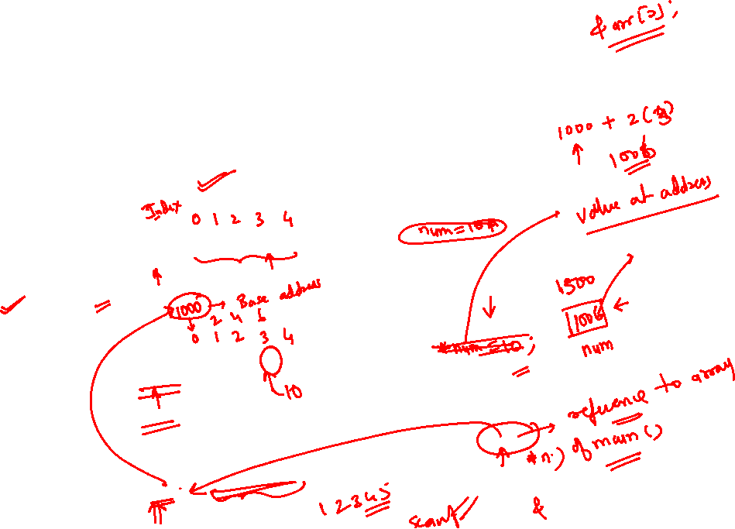
ONE DIMENSIONAL ARRAYS FOR INTER FUNCTION COMMUNICATION
1D Arrays For Inter Function Communication
Passing individual elements
Passing entire array
Passing individual elements
Passing entire array
Passing data values
main() { int arr[5] ={1, 2, 3, 4, 5}; func(arr[3]); } | void func(int num) { printf("%d", num); }
Passing addresses
main() { int arr[5] ={1, 2, 3, 4, 5}; func(&arr[3]); } | void func(int *num) { printf("%d", num); }
Passing the entire array
main() { int arr[5] ={1, 2, 3, 4, 5}; func(arr); } | moid func(int arr[5]) { int i; for(i=0;i<5;i++) printf("%d", arr[i]); }

Slide 10
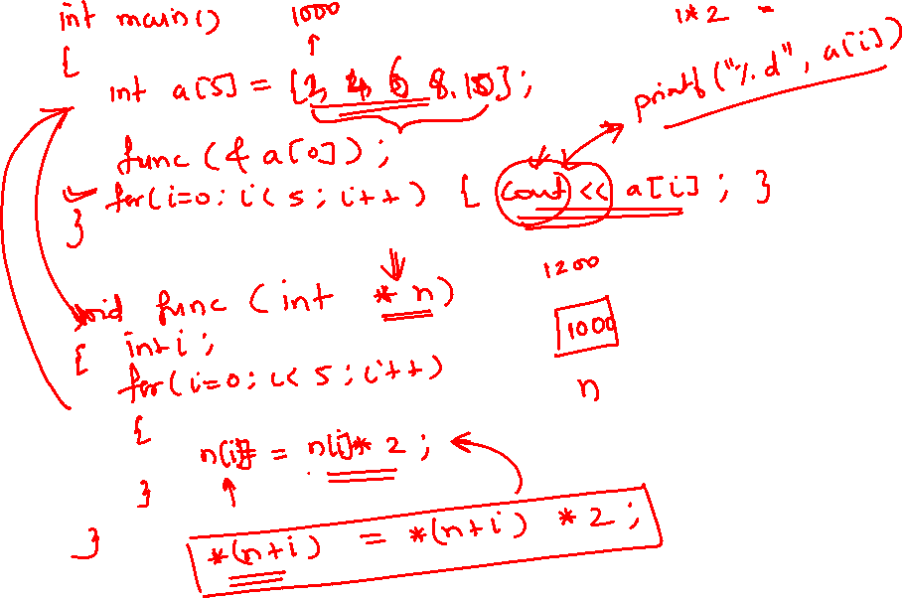

Slide 11
POINTERS AND ARRAYS
int arr[5] = {1, 2, 3, 4, 5};
int *ptr = &arr[0];
ptr++;
printf(“\n The value of the second element of the array is %d”, *ptr);
Write a program to read and display an array of n integers
#include<stdio.h>
int main()
{
int i, n;
int arr[10], *parr;
parr = arr;
printf(“\n Enter the number of elements : “);
scanf(“%d”, &n);
for(i=0; i <n; i++)
scanf(“%d”, (parr+i));
for(i=0; i <n; i++)
printf(“\n arr[%d] = %d”, i, *(parr+i));
}

Slide 12
ARRAY OF POINTERS
An array of pointers can be declared as
int *ptr[10]
The above statement declares an array of 10 pointers where each of the pointer points to an integer variable. For example, look at the code given below.
int *ptr[10];
int p=1, q=2, r=3, s=4, t=5;
ptr[0]=&p;
ptr[1]=&q;
ptr[2]=&r;
ptr[3]=&s;
ptr[4]=&t
Can you tell what will be the output of the following statement?
printf(“\n %d”, *ptr[3]);
Yes, the output will be 4 because ptr[3] stores the address of integer variable s and *ptr[3] will therefore print the value of s that is 4.

Slide 13
TWO DIMENSIONAL ARRAYS
A two dimensional array is specified using two subscripts where one subscript denotes row and the other denotes column.
C looks a two dimensional array as an array of a one dimensional array.
A two dimensional array is declared as:
data_type array_name[row_size][column_size];
Therefore, a two dimensional mXn array is an array that contains m*n data elements and each element is accessed using two subscripts, i and j where i<=m and j<=n
int marks[3][5]
First Dimension
Second Dimension
Rows/Columns | Col 0 | Col 1 | Col2 | Col 3 | Col 4
Row 0 | Marks[0][0] | Marks[0][1] | Marks[0][2] | Marks[0][3] | Marks[0][4]
Row 1 | Marks[1][0] | Marks[1][1] | Marks[1][2] | Marks[1][3] | Marks[1][4]
Row 2 | Marks[2][0] | Marks[2][1] | Marks[2][2] | Marks[2][3] | Marks[2][4]
Two Dimensional Array

Slide 14
MEMORY REPRESENTATION OF A TWO DIMENSIONAL ARRAY
There are two ways of storing a 2-D array can be stored in memory. The first way is row major order and the second is column major order.
In the row major order the elements of the first row are stored before the elements of the second and third row. That is, the elements of the array are stored row by row where n elements of the first row will occupy the first nth locations.
(0,0) (0, 1) (0,2) (0,3) (1,0) (1,1) (1,2) (1,3) (2,0) (2,1) (2,2) (2,3)
However, when we store the elements in a column major order, the elements of the first column are stored before the elements of the second and third column. That is, the elements of the array are stored column by column where n elements of the first column will occupy the first nth locations.
(0,0) (1,0) (2,0) (3,0) (0,1) (1,1) (2,1 (3,1) (0,2) (1,2) (2,2) (3,2)
Address(A[I][J] = Base_Address + w{M ( J - 1) + (I - 1)}, if the array elements are stored in column major order.
And, Address(A[I][J] = Base_Address + w{N ( I - 1) + (J - 1)}, if the array elements are stored in row major order.
Where, w is the number of words stored per memory location
m, is the number of columns
n, is the number of rows
I and J are the subscripts of the array element

Slide 15
TWO DIMENSIONAL ARRAYS CONTD..
A two dimensional array is initialized in the same was as a single dimensional array is initialized. For example,
int marks[2][3]={90, 87, 78, 68, 62, 71};
int marks[2][3]={{90,87,78},{68, 62, 71}};
Write a program to print the elements of a 2D array
#include<stdio.h>
#include<conio.h>
main()
{
int arr[2][2] = {12, 34, 56,32};
int i, j;
for(i=0;i<2;i++)
{
printf("\n");
for(j=0;j<2;j++)
printf("%d\t", arr[i][j]);
}
return 0;
}

Slide 16
TWO DIMENSIONAL ARRAYS FOR INTER FUNCTION COMMUNICATION
2D Array for Inter Function Communication
Passing individual elements
Passing a row
Passing the entire 2D array
There are three ways of passing parts of the two dimensional array to a function. First, we can pass individual elements of the array. This is exactly same as we passed element of a one dimensional array.
Passing a row
main() { int arr[2][3]= ( {1, 2, 3}, {4, 5, 6} }; func(arr[1]); }
void func(int arr[]) { int i; for(i=0;i<5;i++) printf("%d", arr[i] * 10); }
Passing the entire 2D array
To pass a two dimensional array to a function, we use the array name as the actual parameter. (The same we did in case of a 1D array). However, the parameter in the called function must indicate that the array has two dimensions.

Slide 17

PROGRAM ILLUSTRATING PASSING ENTIRE ARRAY TO A FUNCTION
#include<stdio.h>
void read_matrix(int mat[][], int, int);
void sum_matrix(int mat1[][], int mat2[][], int, int);
void display_matrix(int mat[5][5], int r, int c);
int main()
{ int row, col, mat1[5][5], mat2[5][5];
printf(“\n Enter the number of rows and columns of the matrix : “);
scanf(“%d %d”, row, col);
read_matrix(mat1, row, col);
printf(“\n Enter the second matrix : “);
read_matrix(mat2, row, col);
sum_matrix(mat1, mat2, row, col);
}
void read_matrix(int mat[5][5], int r, int c)
{ int i, j;
for(i=0;i<r;i++)
{ for(j=0;j<c;j++)
{ printf(“\n mat[%d][%d] = “);
scanf(“%d“, &mat[i][j]);
}
}
}
void sum_matrix(int mat1[5][5], mat2[5][5], int r, int c)
{ int i, j, sum[5][5];
for(i=0;i<r;i++)
{ for(j=0;j<c;j++)
sum[i][j] = mat1[i][j] + mat2[i][j];
}
display_matrix(sum, r, c);
}
void display_matrix(int mat[5][5], int r, int c)
{ int i, j;
for(i=0;i<r;i++)
{ printf(“\n”);
for(j=0;j<c;j++)
printf(“\t mat[%d][%d] = %d“, mat[i][j]);
}
}

